Slide 1
Arithmetic Operations and I/O

Slide 2
ADC – Add with Carry
adc: Similar to the add instruction but also adds the carry bit generated by a previous operation.
This instruction is used in extended arithmetic
adding two 64-bit numbers on the 32-bit 68K

Slide 3
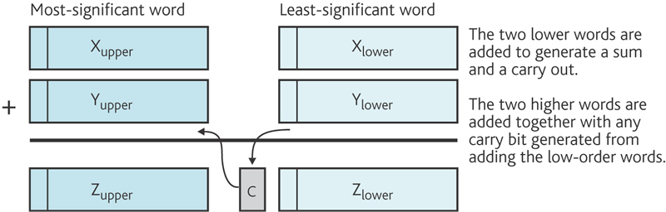
ADC – Add with Carry

Slide 4
64-bit addition X + Y
Assembler form | Operation
ADD.L D0,D2 | Add the low-order 32-bits and update the carry flag.
ADDX D1,D3 | Add the high-order 32-bits plus any carry.

Slide 5
Arithmetic Instructions
Assembler form | Register Transfer Level (RTL) Description | Operation
MULU D0,D1 | [D1] ← [D1]*[D0] | Multiply(unsigned)
MULS D0,D1 | [D1] ← [D1] *[D0] | Multiply(signed)
DIVU D0,D1 | [D1] ← [D1]/[D0] | Divide(unsigned)
DIVS D0,D1 | [D1] ← [D1]/[D0] | Divide(signed)

Slide 6
Multiplication
Two’s complement arithmetic works for addition and subtraction
Different operations are required for multiplication and division of unsigned and signed integers
68K has two multiplication (and division) instructions
Choice reflects type of numbers operated on
Multiplication of two 16-bit numbers to produces a 32-bit result
MULU
multiplies two unsigned integers
MULS
multiplies two signed integers

Slide 7
Division
Division results in a quotient plus a remainder.
The 68K divides a 32-bit value by a 16-bit value to produce a 16-bit quotient and a 16-bit remainder.
The quotient and the remainder are packed in the same register
DIVU D0,D1 Divides 32-bit contents of D1 by the 16-bit lower-order 16-bit word in D0
16-bit quotient is put in low-order word of D1
16-bit remainder in the high-order word of D1

Slide 8
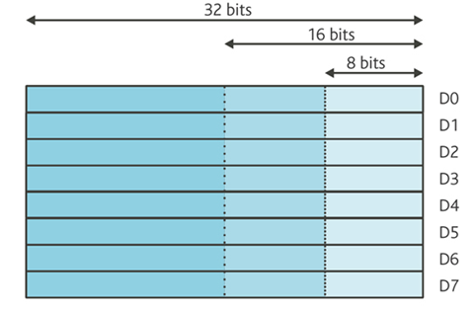
Division
DIVU D0, D1
[D0_{(0:15)}]
0
7
[D1_{(0:31)}]
41

Slide 9
Division
DIVU D0, D1
[D0_{(0:15)}]
0
7
[D1_{(0:31)}]
5
[D1_{(0:15)}] quotient

Slide 10
Division
DIVU D0, D1
[D0_{(0:15)}]
0
7
[D1_{(0:31)}]
6
5
[D1_{(15:31)}] remainder

Slide 11
Division
DIVU D0, D1
[D0_{(0:15)}]
0
7
[D1_{(0:31)}]
6
5
[D1_{(15:31)}] remainder

Slide 12
CLR - Clear
CLR: The clear instruction loads the contents of the specified register with zero
CLR instruction is fast and often used to initialize registers, memory locations
CLR.B D0
is identical to but faster than
MOVE.B #0, D0

Slide 13
NEG - Negate
NEG: The negate instruction subtracts the destination operand from zero and deposits the result at the destination address i.e NEG X has the effect of calculating –X.
This instruction has only one operand, which may be a memory location ( NEG address) or a data register (NEG D1). The instruction simply forms the 2’s complement of a number
Example:
If [D4] = 01101100
Executing
NEG.B D4
results in [D4]=10010100

Slide 14
EASy68K
ORG $1000
START:
LEA MESSAGE,A1
MOVE.B #14,D0
TRAP #15
SIMHALT
MESSAGE DC.B 'Hello Assembly',0
END START

Slide 15
Trap Tasks
http://www.easy68k.com/QuickStart/TrapTasks.htm
TRAP #15 is used for I/O. Put the task number in D0.

Slide 16
Trap Tasks
0 | Display string at (A1), D1.W bytes long (max 255) with carriage return and line feed (CR, LF). (see task 13)
1 | Display string at (A1), D1.W bytes long (max 255) without CR, LF. (see task 14)
2 | Read string from keyboard and store at (A1), NULL terminated, length retuned in D1.W (max 80)
3 | Display signed number in D1.L in decimal in smallest field. (see task 15 & 20)
4 | Read a number from the keyboard into D1.L.
5 | Read single character from the keyboard into D1.B.
6 | Display single character in D1.B.
7 | Set D1.B to 1 if keyboard input is pending, otherwise set to 0. Use code 5 to read pending key.
8 | Return time in hundredths of a second since midnight in D1.L.
9 | Terminate the program. (Halts the simulator)
10 | Print the NULL terminated string at (A1) to the default printer. (Not Teesside compatible.) Always send a Form Feed character to end printing. (See below.)

Slide 17
Trap Tasks
11 | Position the cursor at ROW, COL. The high byte of D1.W holds the COL number (0-79), The low byte holds the ROW number (0-31). 0,0 is top left 79,31 is the bottom right. Out of range coordinates are ignored. Clear Screen : Set D1.W to $FF00.
12 | Keyboard Echo. D1.B = 0 to turn off keyboard echo. D1.B = non zero to enable it (default). Echo is restored on 'Reset' or when a new file is loaded.
13 | Display the NULL terminated string at (A1) with CR, LF.
14 | Display the NULL terminated string at (A1) without CR, LF.
15 | Display the unsigned number in D1.L converted to number base (2 through 36) contained in D2.B. For example, to display D1.L in base16 put 16 in D2.B Values of D2.B outside the range 2 to 36 inclusive are ignored.

Slide 18
Trap Tasks
16 | Adjust display properties D1.B = 0 to turn off the display of the input prompt. D1.B = 1 to turn on the display of the input prompt. (default) D1.B = 2 do not display a line feed when Enter pressed during Trap task #2 input D1.B = 3 display a line feed when Enter key pressed during Trap task #2 input (default) Other values of D1 reserved for future use. Input prompt display is enabled by default and by 'Reset' or when a new file is loaded.
17 | Combination of Trap codes 14 & 3. Display the NULL terminated string at (A1) without CR, LF then Display the decimal number in D1.L.
18 | Combination of Trap codes 14 & 4. Display the NULL terminated string at (A1) without CR, LF then Read a number from the keyboard into D1.L.

Slide 19
Trap Tasks
19 | Returns current state of up to 4 specified keys or returns key scan code. Pre: D1.L = four 1-byte key codes Post: D1.L contains four 1-byte Booleans. $FF = corresponding key is pressed, $00 = corresponding key not pressed. Pre: D1.L = $00000000 Post: D1.B contains key code of last key pressed
20 | Display signed number in D1.L in decimal in field D2.B columns wide.
21 | Set Font Color D1.L = color as $00BBGGRR BB is amount of blue from $00 to $FF GG is amount of green from $00 to $FF RR is amount of red from $00 to $FF D2.B = style by bits, 0 = off, 1 = on bit0 is Bold bit1 is Italic bit2 is Underline bit3 is StrikeOut

Slide 20
Trap Tasks
22 | Read char at Row,Col of text screen. Pre: D1.L = High 16 bits = Row Low 16 bits = Col Post: D1.B contains ASCII code of character.

Slide 21
EASy68K
ORG $1000
START:
LEA MESSAGE,A1
MOVE.B #14,D0
TRAP #15
SIMHALT
MESSAGE DC.B 'Hello Assembly',0
END START

Slide 22
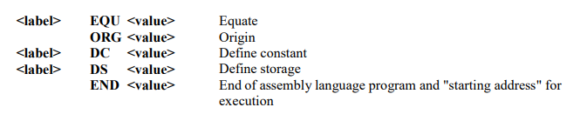
Assembler Directives

Slide 23
EQU
EQU The equate directive simply links a name to a value, making programs much easier to read e.g. it is better to equate the name CAR_RET to $0D and use this name in a program rather than writing $0D and leaving it to the reader to figure out that $0D is the ASCII value for carriage return!

Slide 24
EQU
In other words, EQU assembler directive equates a symbolic name to a numeric value. It defines constants.
The syntax of the EQU directive is as follows:
TOTSTUDENTS EQU 50

Slide 25
DC.B
[<label>] DC.B <string> [<label>] DC.B <data list> [<label>] DC.W <data list> [<label>] DC.L <data list>
If a length extension (.B, .W, or .L) is not specified, the byte value is used for strings and the word value for numeric data. All data will be rounded to word size. This means that an extra byte will be added to the end of a constant DC.B declaration if the string or numeric list have an odd number items.

Slide 26
DC Directive ORG $00001000
Address | Memory | Contents | Instruction
001000 | 0A | 42 | DC.B 10,66
001002 | 0 | 0A | DC.L $0a1234
001004 | 12 | 34
001006 | 41 | 70 | DC.B 'April 8 1985'
001008 | 72 | 69
00100A | 6C | 20
00100C | 38 | 20
00100E | 31 | 39
001010 | 38 | 35
001012 | 0 | 0 | DC.L 1,2
001014 | 0 | 1
001016 | 0 | 0
001018 | 0 | 2

Slide 27
string1: dc.b 'hello’
This creates a string 'hello' whose storage address begins at string1.
string1 will be replaced by the corresponding constant (hello).

Slide 28
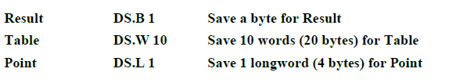
DS
The define storage directive is used to reserve one or more memory locations.

Slide 29
DC, DS and EQU
DC – defines a constant directive and loads a constant into memory
DS – defines a storage directive and reserves memory space for variables
EQU – binds a name to a value

Slide 30
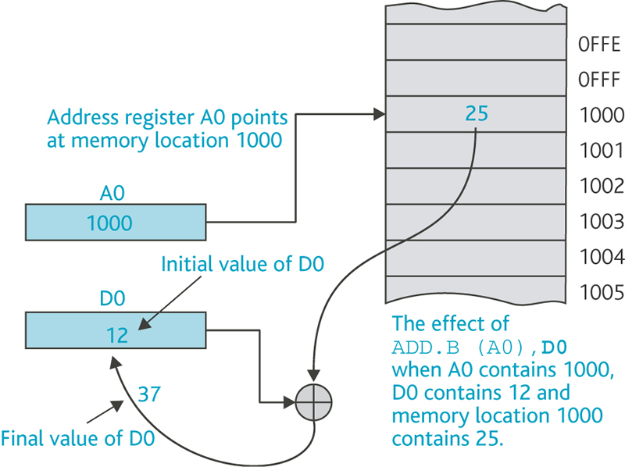
Accessing Data in Address Registers

Slide 31
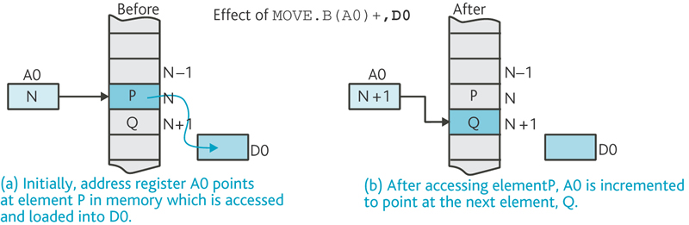
Accessing and incrementing

Slide 32
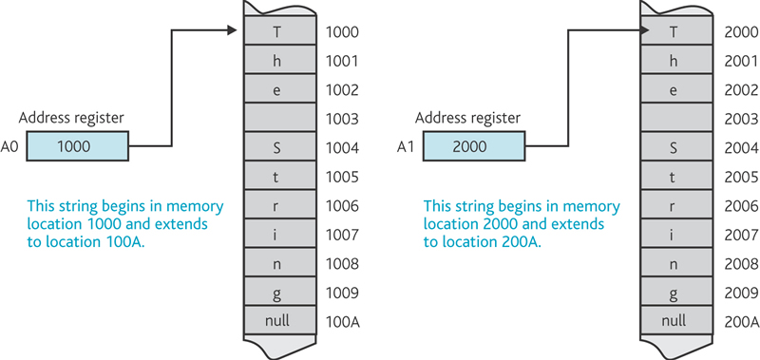
Address registers and Strings

Slide 33
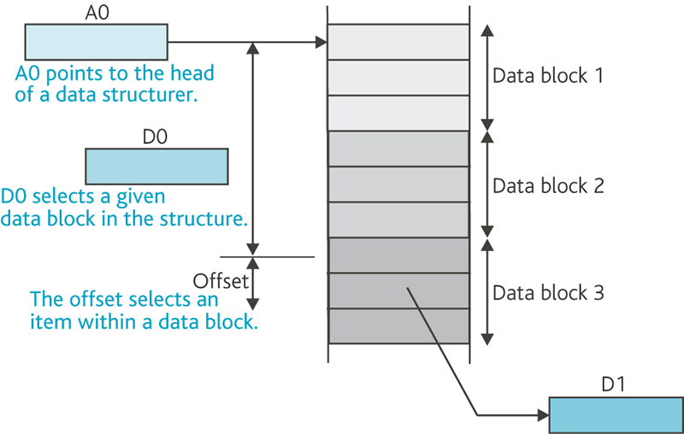
The Power of Offsets

Slide 34
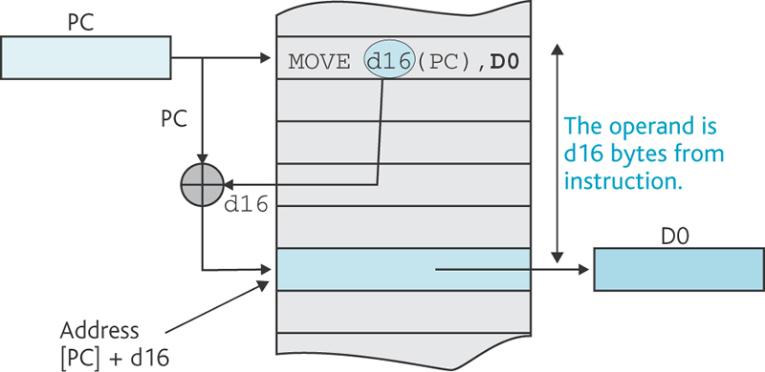
Offset example using the Program counter
Example: 0xf(a1) is the data contained in memory at the address a1 + 0xf (base address + offset)

Slide 35
References
Mini guide to 68000 Assembly Programming (https://simpledevcode.wordpress.com/2016/12/15/mini-guide-to-68000-assembly-programming/)
https://www.cs.mcgill.ca/~cs573/fall2002/notes/lec273/lecture9/
68K User Manual (https://fiona.dmcs.pl/pn/asembler_68000/asm.html)
http://alanclements.org/68kaddressingmodes3.html
MarkeyJester’s Motorola 68000 Beginner’s Tutorial (https://mrjester.hapisan.com/04_MC68/Index.html)

